Slide 1


SAP CLOUD APPLICATION PROGRAMMING AND XSA TRAINING IN BPT
Anubhav Oberoy
Day – 5

Slide 2

Agenda – Day 5
Concept of Localization
Localization of Dynamic Content
Localization of Static Content
Loading data in Database

Slide 3
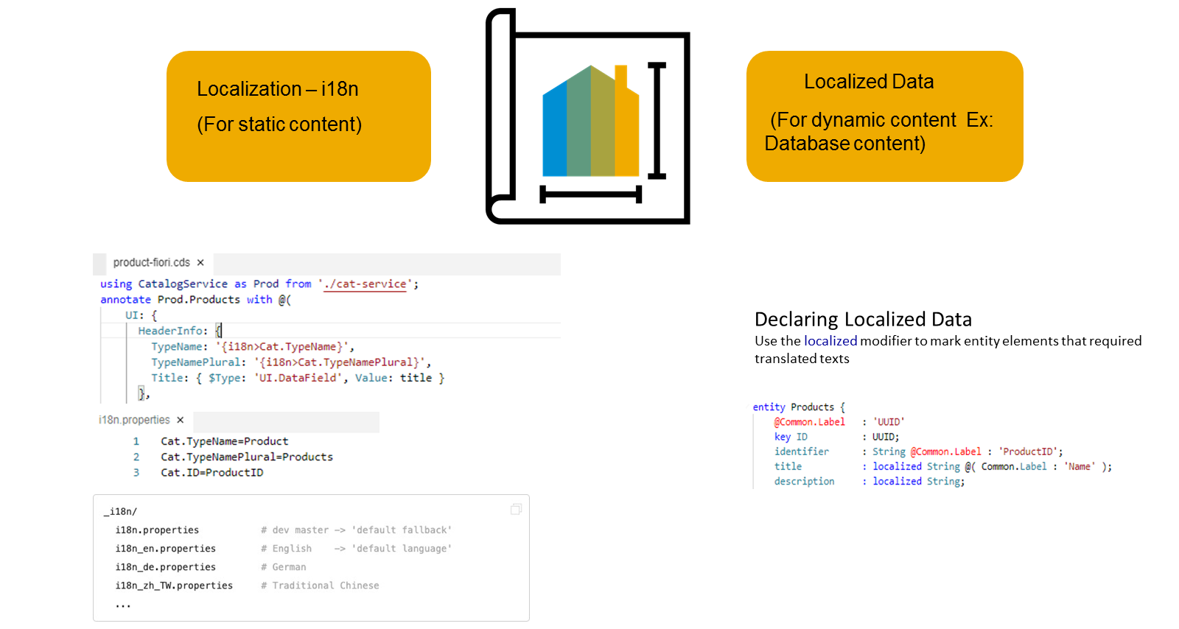
Concept of Localization
Localization refers to adapting your business application to different languages to cater to specific regional markets. This is important for anything that is visible in the UIs.
Localization is split into two categories, Localization for static content and Localization for dynamic content
Localization for dynamic content
This is achieved by marking the attributes that need to support multiple languages with a special keyword called "localized", this then creates a text table for each entity which has attributes defined as "localized"
Dynamic content that depends on the data that is stored in our persistence service.
The attributes that need to support multiple languages need to be marked with a special keyword called "localized", as we see here. In this case a text table is created for the entity.
DESCRIPTION: localized String(255);

Slide 4
Localization for Static Content
This is achieved by externalizing all your text literals into separate text bundle files that we call the internationalization files, or in short, i18n files.
You need to maintain a separate i18n file for each language that you'd like to support.
In these i18n files, we store the actual static text as key and value pairs. Your code can then refer to the respective keys as we see here in this picture.

Slide 5

Hands-on: Localization of Data
Now we will use the annotation to give labels to the entities in our datamodel. To check the labels in the metadata we have implement a service and expose the business partner entity in the service.
Part 1: Annotating the entity in the same file
Exercise code/resource:
datamodel.cds
CatalogService.cds
CatalogService.js
i18n.properties
Part 2: Annotating the properties from another file.
Exercise code/resources:
index.cds
datamodel.cds
i18n.properties
i18n_de.properties

Slide 6
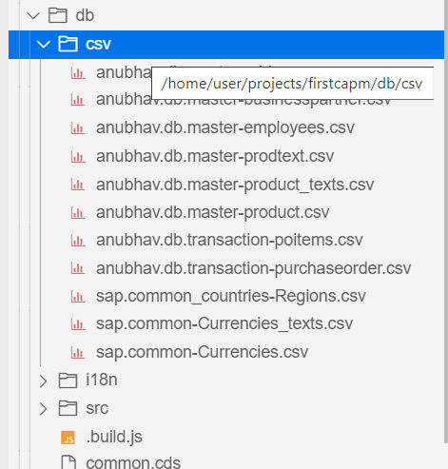
Loading initial Data in HANA Database
CSV files in your project are picked up by deployments for both SQLite and SAP HANA.
Steps to add data
The files must be located in the db/csv, db/data, or db/src/csv folders.
Each file contains data for one entity.
Filenames must follow the pattern namespace-entity.csv.
Pattern for nested entities: namespace-entity.nestedEntity.csv.
Examples: anubhav.db.master-address.csv
They must start with a header line that lists the needed element names.
When we do cds deploy --to hana
Behind the scenes it generates hdbtabledata files for the CSV files in the project. If an hdbtabledata file is already present next to the CSV files, no new file is generated.

Slide 7
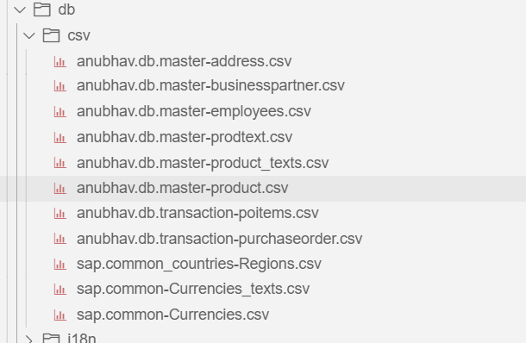
Hands-on: Loading Initial Data
In this exercise we will deploy the business partner table and address table to the HANA Cloud Database.
Exercise code/resource:
csv files

Slide 8
Title
Content

Slide 9
Title
Content

Slide 10
Title
Content

Slide 11
Title
Content

Slide 12

End of Day 5

Slide 13

Questions

Slide 14

Anubhav Oberoy

Slide 15


We’re committed to empower you to be
Most Desirable Resource
through powerful training solutions.
We build the workforce of the future.
250+
Corporate Clients
30,000+
Learners Trained
25000+
Learners Placed
FREE WEBINARS
Sign up for free webinars with industry experts every fortnight!
Enroll Now!
Contact us today!
https://anubhavtrainings.com/

Slide 16




More from AnubhavTrainings.com

Slide 17
Title
Content

